Slide 1

SC C & D
FALL 2019
Lecture : Arrays

Slide 2
Arrays
Java provides a data structure
the array, which stores a fixed-size sequential collection of elements of the same type
An array is used to store a collection of data
But it is often more useful to think of an array as a collection of variables of the same type.

Slide 3
Why we Arrays
Instead of declaring individual variables
Declare one array variable such as numbers and use
What if we want to declare and save 100 values??

Slide 4
Why we Arrays
int num1=100;
int num2= 200;
int num3=300;
.
.
.
.
int num99=900;
Is that a good way?? No

Slide 5
Why we Arrays
Better way is to declare array and access element by
num[0], num[1], and ..., num[99]

Slide 6
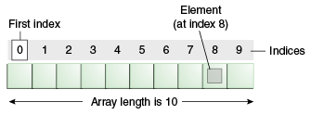
Arrays
An array of 10 elements

Slide 7
Declaring Array Variables
Declare a variable to reference the array
Must specify the type of array the variable can reference
Syntax for declaring an array variable

Slide 8
Declaring Array Variables
dataType[] arrayRefVar; // preferred way.
or
dataType arrayRefVar[]; // works but not preferred way.

Slide 9
Example Declaring Array Variables
double[] myList; // preferred way.
or
double myList[]; // works but not preferred way.

Slide 10
Creating Arrays
arrayRefVar = new dataType[arraySize];
The above statement does two things:
It creates an array using new dataType[arraySize];
It assigns the reference of the newly created array to the variable arrayRefVar.

Slide 11
Example
mylist= new int[100];

Slide 12
Declare & Create Array at once
dataType[] arrayRefVar = new dataType[arraySize];
Alternatively you can create arrays as follows:
dataType[] arrayRefVar = {value0, value1, ..., valuek};
The array elements are accessed through the index.
Array indices are 0-based;
that is, they start from 0 to arrayRefVar.length-1.

Slide 13
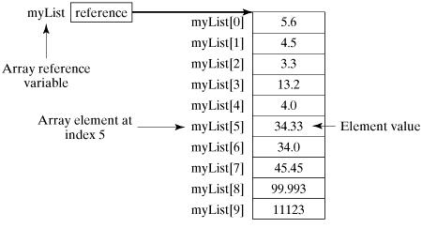
Example
double[] myList = new double[10];

Slide 14
Processing an Array
When processing array elements,
we often use either for loop or foreach loop because all of the elements in an array are of the same type and the size of the array is known

Slide 15
How to create, initialize and process arrays
public class TestArray {
public static void main(String[] args) {
double[] myList = {1.9, 2.9, 3.4, 3.5};
// Print all the array elements
for (int i = 0; i < myList.length; i++) {
System.out.println(myList[i] + " ");
}
// Summing all elements
double total = 0;
for (int i = 0; i < myList.length; i++) {
total += myList[i];
}
System.out.println("Total is " + total);
// Finding the largest element
double max = myList[0];
for (int i = 1; i < myList.length; i++) {
if (myList[i] > max) max = myList[i];
}
System.out.println("Max is " + max);
}
}

Slide 16
Pass a Array into Function
public static void printArray(int[] array) {
for (int i = 0; i < array.length; i++) {
System.out.print(array[i] + " ");
}
}

Slide 17
Returning an Array from a Method:
public static int[] reverse(int[] list) {
int[] result = new int[list.length];
for (int i = 0, j = result.length - 1; i < list.length; i++, j--) {
result[j] = list[i];
}
return result;
}

Slide 18
Declare Array of following data type
byte[] anArrayOfBytes;
short[] anArrayOfShorts;
long[] anArrayOfLongs;
float[] anArrayOfFloats;

Slide 19
Declare Array of following data type
double[] anArrayOfDoubles;
boolean[] anArrayOfBooleans;
char[] anArrayOfChars;
String[] anArrayOfStrings;

